Slide 1
IT Security and Penetration Testing
Chapter 5
TCP/IP Vulnerabilities

Slide 2
Objectives
Give a definition of TCP/IP
Know the steps of TCP/IP communication
Recognize weaknesses in TCP/IP
Identify steps in protecting information from vulnerabilities in TCP/IP
Computer Security and Penetration Testing

Slide 3
TCP/IP Vulnerabilities
Transmission Control Protocol/Internet Protocol (TCP/IP)
  Suite of protocols that underlie the Internet
  Comprises many protocols and applications
  Common language of networked computers
  Makes transferring information fast and efficient
IP has tools to correctly rout packets
TCP is responsible for safe and reliable data transfer between host computers
Computer Security and Penetration Testing

Slide 4
TCP/IP Vulnerabilities (continued)
Illegitimate users take advantage of TCP/IP vulnerabilities
  By exploiting the “three-way handshake”
Unauthorized users may launch a denial-of-service attack on the destination computer
  Floods network with so many additional requests that regular traffic is slowed or completely interrupted
Computer Security and Penetration Testing

Slide 5
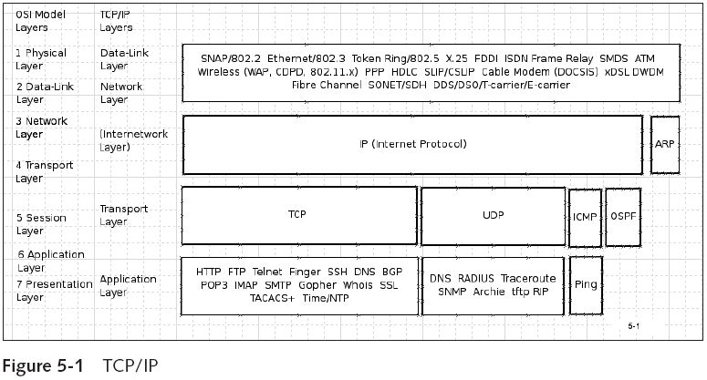
TCP/IP Vulnerabilities (continued)
Computer Security and Penetration Testing

Slide 6
Data Encapsulation
Data encapsulation
  Enclosing higher-level protocol information in lower-level protocol information
  Also called data hiding
  Implementation details of a class are hidden from user
Computer Security and Penetration Testing

Slide 7
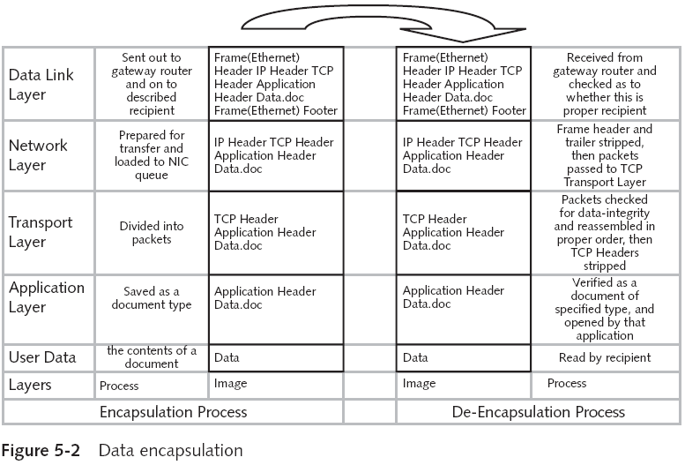
Data Encapsulation (continued)
Computer Security and Penetration Testing

Slide 8
IP (Internet Protocol)
Internet Protocol (IP)
  Transmits data from source to final destination
  Network protocol operating at layer 3 of the OSI Model
    And layer 2 or 3 of the TCP/IP Model
  IP is connectionless
    No guarantee of delivery of packets to the destination
IP routes packets over network hardware
Computer Security and Penetration Testing

Slide 9
IP (Internet Protocol) (continued)
IP addresses formats
  IPv4 (32-bit address)
    Usually written as a dotted-decimal, e.g., 192.168.100
  IPv6 (128-bit address)
    Usually written as eight groups of four hex digits, e.g.,
      2001:0db8:85a3:08d3:1319:8a2e:0370:7334
IP address exhaustion date
  Approximately the beginning of 2011
Computer Security and Penetration Testing

Slide 10
IP (Internet Protocol) (continued)
IP packets often arrive out of sequence
  Vulnerability that attackers can exploit
When a large IP packet is sent over a network, it is broken down
  Called fragmentation
Computer Security and Penetration Testing

Slide 11
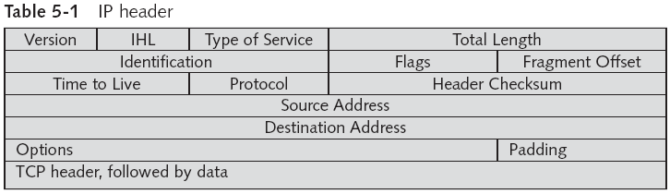
IP (Internet Protocol) (continued)
Computer Security and Penetration Testing

Slide 12
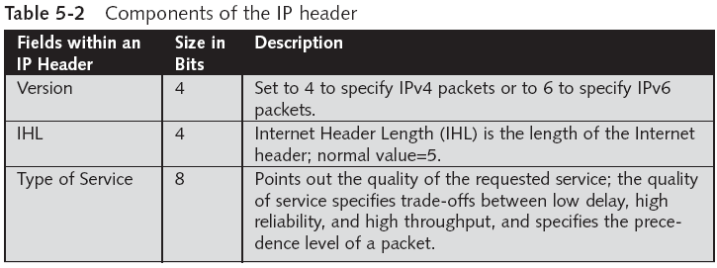
IP (Internet Protocol) (continued)
Computer Security and Penetration Testing

Slide 13
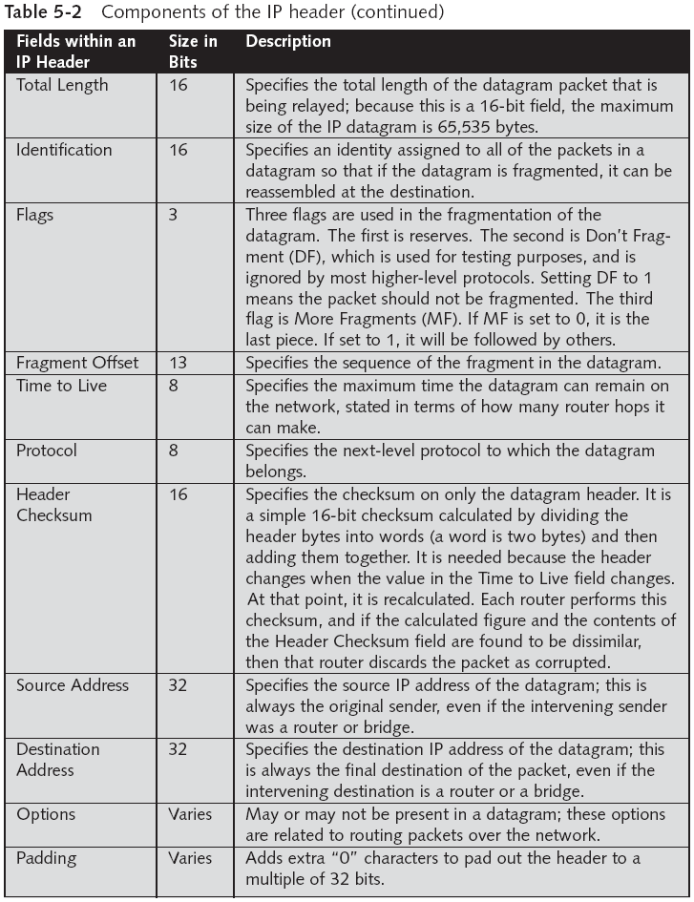
Computer Security and Penetration Testing

Slide 14
TCP
Uses a connection-oriented design
  Participants in a TCP session must create connection
Connection is called the three-way handshake
Provides connection-oriented services between a source and destination computer
  And guarantees delivery of packets
Packets reach the application layer in the right order
  TCP identifies and assembles packets based on sequence numbers
Computer Security and Penetration Testing

Slide 15
TCP (continued)
Source and destination computers exchange the initial sequence number (ISN)
  When a connection is made
Packets are accepted within a particular range
  Specified during the establishment of a connection
Computer Security and Penetration Testing

Slide 16
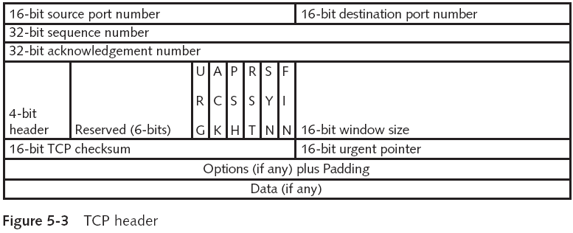
TCP (continued)
Computer Security and Penetration Testing

Slide 17
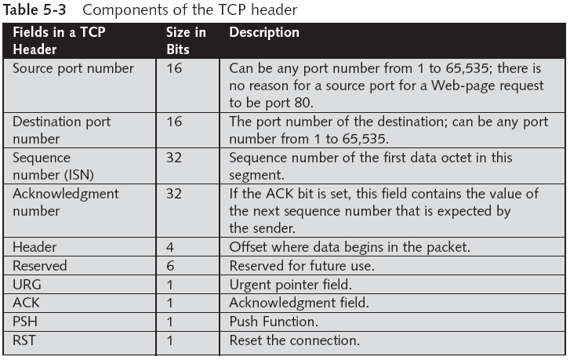
TCP (continued)
Computer Security and Penetration Testing

Slide 18
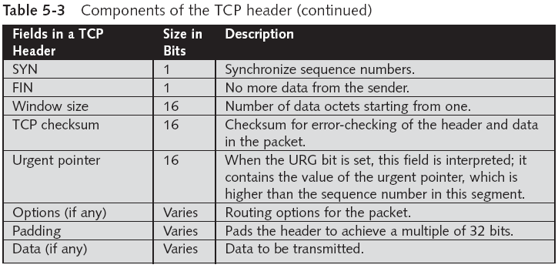
TCP (continued)
Computer Security and Penetration Testing

Slide 19
Connection Setup and Release
Three-way handshake sets up and releases a connection
TCP packet flags: URG,ACK, PSH,RST,SYN, and FIN
Packets can have more than one flag set
  Normally a packet will have only one flag sent, except with SYN/ACK or FIN/ACK
Three packets in a TCP connection:
  SYN --> SYN/ACK --> ACK
Computer Security and Penetration Testing

Slide 20
Connection Setup and Release (continued)
Connection Setup
  Source computer delivers a SYN packet to the destination computer
    Packet has the initial sequence number (ISN)
    ISN is indicated by whether the SYN bit is “set”
  Receiving computer transmits a SYN with an acknowledgment, ACK
  Source computer sends an ACK to the destination computer as a response
    With an “in-range” sequence number
Computer Security and Penetration Testing

Slide 21
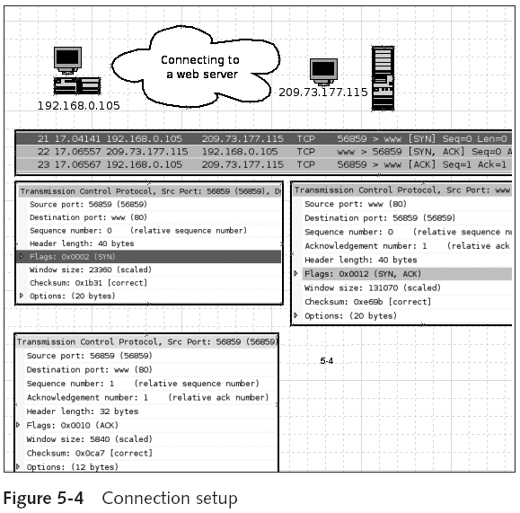
Computer Security and Penetration Testing

Slide 22
Connection Setup and Release (continued)
Connection Release
  Source computer sends a FIN packet to the destination computer
  Destination computer then sends a FIN/ACK packet
  Source computer sends an ACK packet
  Either computer could send an RST and close the session (reset) immediately
Computer Security and Penetration Testing

Slide 23
TCP Timers
All TCP sessions are tracked with timers built into the TCP protocol
Timers used by TCP/IP
  Connection establishment
    A session will not be established if it takes longer than 75 seconds for the destination server to respond
  FIN_WAIT
    Waits for FIN packets. Its default value is 10 minutes
Computer Security and Penetration Testing

Slide 24
TCP Timers (continued)
Timers used by TCP/IP (continued)
  TIME_WAIT
    Default value for this timer is two minutes
    Waits for packets to arrive at the destination computer
  KEEP_ALIVE
    Checks to see if the destination computer is active
    Computer may send a test packet every two hours to verify whether the other computer is alive and idle
Computer Security and Penetration Testing

Slide 25
Vulnerabilities in TCP/IP
During the development of TCP/IP in the 1980s
  Security was not a priority
Since 1990, security has become a serious problem
Some of the vulnerabilities
  IP spoofing
  Connection hijacking
  ICMP attacks
  TCP SYN attacks
  RIP attacks
Computer Security and Penetration Testing

Slide 26
IP Spoofing
Steps
  Attackers send packets to the victim or target computer with a false source address
  Victim accepts the packet and sends a response “back” to the indicated source computer
  Attacker must guess the proper sequence numbers to send the final ACK packet
Hacker may have a connection to victim’s machine
  And hold it as long as the computer remains active
Computer Security and Penetration Testing

Slide 27
IP Spoofing (continued)
Sequence Guessing
  Hacker sends a few connections to the victim
    Learns how quickly sequence number is incrementing
  Attacker then sends a spoofed ACK packet with a “best guess” victim’s sequence number
  Hacker can guess the sequence number because the number is generated using a global counter
    And is incremented in fixed units
Computer Security and Penetration Testing

Slide 28
IP Spoofing (continued)
Source Routing
  Sender using source routing can specify return path
    Through which the destination computer sends its reply
  Attacker looks for an intermediate computer or router
    That could forward packets to the target computer
  Most newer routers and firewalls are configured to drop source-routed packets
Computer Security and Penetration Testing

Slide 29
Connection Hijacking
Connection hijacking
  Allows an attacker to control an existing connection
Steps
  An attacker desynchronizes a series of packets between the source and destination computer
  Extra packets sent to one of the victims force the victim to choose which packet to accept
  If the victim chooses to discard the authentic packets and interacts with the spoofed packets
    The attacker has hijacked the connections
Computer Security and Penetration Testing

Slide 30
ICMP Attacks
Packets are used to send fraudulent or deceptive connection information among computers
ICMP is used to test for connectivity using utilities such as the ping command
Denial-of-service (DoS) attacks can be formulated by using ICMP packets
  Destination Unreachable and Time to Live Exceeded
Attackers transmitting spoofed packets can successfully reset existing connections
Computer Security and Penetration Testing

Slide 31
TCP SYN Attacks
Exploits host implementation of three-way handshake
When Host B receives the SYN request from A, it must keep track of the partially opened connection
  In a queue for at least 75 seconds
Most systems are limited and can keep track of only a small number of connections
An attacker can overflow the listen queue by sending more SYN requests than the queue can handle
  SYN flooding
Computer Security and Penetration Testing

Slide 32
RIP Attacks
Take advantage of RIP (Routing Information Protocol)
RIP
  Essential component in a TCP/IP network
  Distribution of routing information within networks
RIP packet is often used without verification
  Attacks on RIP change the destination of data
Once the router is modified, it transmits all of the packets to the hacker computer
Computer Security and Penetration Testing

Slide 33
Securing TCP/IP
Data in packets is not encrypted or authenticated
Packet sniffer can observe contents of the packets
Attackers can send spoofed packets from any computer
Must employ many methods simultaneously to achieve success in this area
Computer Security and Penetration Testing

Slide 34
Securing TCP/IP (continued)
Methods to decrease vulnerabilities in TCP/IP
  Modify default timer values
  Increase the number of simultaneous connections that a computer can handle
  Reduce the time limit used to listen for replies to the SYN/ACK in the three-way handshake
  Change method used to generate sequence numbers
  Firewall rules that block spoofed packets
Computer Security and Penetration Testing

Slide 35
Securing TCP/IP (continued)
Methods to decrease vulnerabilities in TCP/IP (continued)
  Avoid using the source address authentication
  If an operator allows outside connections from trusted hosts, enable encryption sessions at the router
  Packets can be encrypted or sent via encrypted VPN
Computer Security and Penetration Testing

Slide 36
IP Security Architecture (IPSec)
IP Security Architecture (IPSec)
  Collection of Internet Engineering Task Force (IETF) standards
  Defines an architecture at the Internet Protocol (IP) layer that protects IP traffic
    By using various security services
Computer Security and Penetration Testing

Slide 37
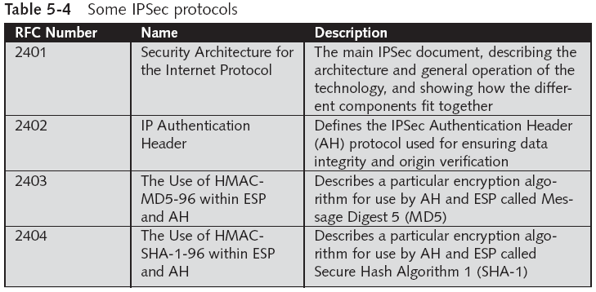
IP Security Architecture (IPSec) (continued)
Computer Security and Penetration Testing

Slide 38
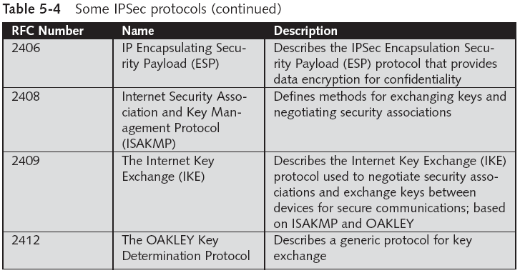
IP Security Architecture (IPSec) (continued)
Computer Security and Penetration Testing

Slide 39
IP Security Architecture (IPSec) (continued)
IPSec provides:
  Encryption of user data for privacy
  Authentication of the integrity of a message
  Protection against certain types of security attacks, such as replay attacks
  Ability for devices to negotiate security algorithms and keys required for secure authenticated connections
  Two security modes, tunnel and transport, to meet different network needs
Computer Security and Penetration Testing

Slide 40
Summary
Internet Protocol (IP) is responsible for sending data from a source computer to a destination computer
TCP guarantees the delivery of packets
Some of the timers that are important for TCP/IP security are Connection Establishment, FIN_WAIT,TIME_WAIT, and KEEP_ALIVE
Vulnerabilities in TCP/IP include TCP SYN attacks, IP spoofing, connection hijacking, RIP attacks, and ICMP attacks
Computer Security and Penetration Testing

Slide 41
Summary (continued)
Vulnerabilities in TCP/IP can be decreased by modifying the default timer values, generating random sequence numbers, properly configured firewalls, TCP wrappers on UNIX and Linux boxes, authentication, or encryption
IP Security Architecture (IPSec) is a collection of Internet Engineering Task Force (IETF) standards
  Defines an architecture at Internet Protocol (IP) layer that protects IP traffic by using various security services
Computer Security and Penetration Testing

Slide 42
Summary (continued)
IPSec provides
  Encryption of user data
  Authentication of message integrity
  Protection against certain types of security attacks, such as replay attacks
  Ability for devices to negotiate security algorithms and keys required for secure authenticated connections
  Two security modes, tunnel and transport, to meet different network needs
Computer Security and Penetration Testing

